Slide 1
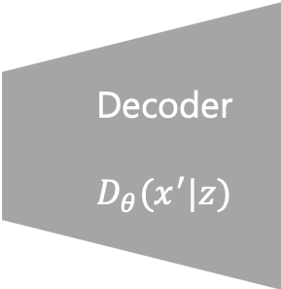
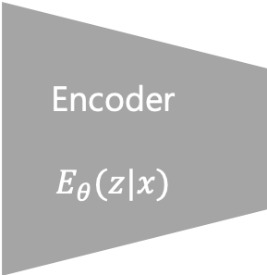
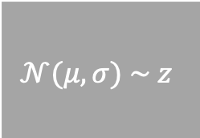


VARIATIONAL AUTO ENCODER
$$μ$$
Encoder
$$E_{θ}(z|x)$$
Decoder
$$D_{θ}(x^{′}|z)$$
$$𝒩(μ, σ) \sim z$$
$$σ$$

Slide 2
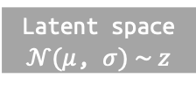
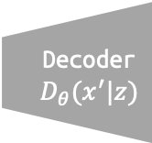

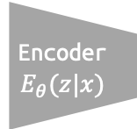



AGENT
a’
a’
CONTROLLER
a
linear controller (equn!)
aaaa
ENV
latent space
h’
VISION
MEMORY
h’, c’
h, c
LSTM
$$μ$$
Mix
Encoder
$$E_{θ}(z|x)$$
Decoder
$$D_{θ}(x^{′}|z)$$
Latent space
$𝒩(μ$, $σ) \sim z$
$$σ$$
$$z′$$
observation
$$π$$

Slide 3
VISION
MEMORY
Latent space z
LSTM hidden state
CONTROLLER

